Slide 1
Intellectual Property (IP)
KT44102/3
Ethics and Law in ICT
Sem 1: 2022/2023
7/11/2022

Slide 2
Content
Introduction
IP Protection
Fair Use
IP: Key Issues

Slide 3
Introduction
Value of intellectual properties much greater than value of media
Creating first copy is costly
Duplicates cost almost nothing
Illegal copying pervasive
Internet allows copies to spread quickly and widely

Slide 4
Introduction : Definition
Term used to describe works of the mind
Distinct and “owned” or created by a person/group
Intellectual property: any unique product of the human intellect that has commercial value
Books, songs, movies
Paintings, drawings
Inventions, chemical formulas, computer programs
Intellectual property ≠ physical manifestation

Slide 5
Introduction: Property Right
People have a right…
to property in their own person
to their own labor
to things which they remove from Nature through their labor
As long as…
nobody claims more property than they can use
after someone removes something from common state, there is plenty left over

Slide 6
Introduction: Property Right
Making a Belt Buckle | Writing a Play
Mine metal | Mine the words (language)
Smelt the metal down | Smelt /turn the words into prose/style (scripting)
Cast the metal to belt buckle | Cast/ turn them into a complete play (acting)

Slide 7
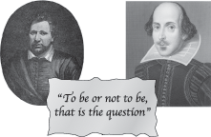
Introduction :Analogy Is Imperfect (Issue)
If Ben Jonson and William Shakespeare simultaneously write down Hamlet, who owns it?
If Ben “steals” the play from Will, both have it
These paradoxes weaken the argument for a natural right to intellectual property

Slide 8
IP Protection : Why
Some people are altruistic; some are not
Allure of wealth can be an incentive for speculative work
Giving creators rights to their inventions stimulates creativity
Society benefits most when inventions in public domain
Compromise by giving authors and inventors rights for a limited time.

Slide 9
IP: Tread Secret
Trade secret
Business information
Represents something of economic value
Required an effort/cost to develop
Some degree of uniqueness/novelty
Generally unknown to public
Kept confidential

Slide 10
IP: Tread Secret
Confidential piece of intellectual property that gives company a competitive advantage
Never expires
Not appropriate for all intellectual properties
Reverse engineering allowed
May be compromised when employees leave firm (Employees are the greatest threat to trade secrets)

Slide 11





IP: Trade/Service Mark
Any sign (Presented graphically) capable of distinguishing goods/services.
Sign : e.g., any letter, word, name signature, shape… and any combinations of thereof.
Collective Mark: A proprietor of the collective mark from those of other undertakings
Certification Mark: Be used are certified by proprietor of the mark in respect of origin, material, mode of manufacture of goods or performance of services, quality, accuracy or other characteristics

Slide 12
IP: Trade/Service Mark
Non- registrable trade mark
Prohibited marks – to confuse/deceive the public/contrary to law
Scandalous of Offensive matter – not be entitled to protection in any court of law
Prejudicial to the interest/security of the nation - Registrar bears the responsibility of determining the trade mark, whether it might be prejudicial to the interest or security of the nation. It may be that a mark contains an inflammatory statement or words

Slide 13
IP: Trade Mark (The need)
Origin – helps to identify the source and those linked for the products and services trade in the market
Choice – assists consumers to choose goods and services with ease
Quality – Consumers define a certain trade mark for its known quality
Marketing – significant role in promoting (branding)
Economic – Recognized trade mark is a valuable asset. Trade marks may be licensed or franchised

Slide 14
IP: Trade Mark
Exclusive Right
To use the marks in trading
To take legal action for infringement
To take civil action/lodges complains
Legal evidence
Legal evidence – the registration certificate
Duration : valid for 10 year (renewed)

Slide 15
IP: Copyright
Please refer to PPT: Special Topic – Malaysia cyberlaw (Copy right part)
Key concept: an idea cannot be copyrighted, but the expression of an idea can be

Slide 16
IP: Patent
Definition: an exclusive right granted for an invention, which is a product or a process that provides a new way of doing something, or offers a new technical solution to a problem. (A public document)

Slide 17
IP: Patent
Patentable Inventions
New (has not been publicity disclosed in any form)
Involve an inventive step (must not be obvious to someone with knowledge and experience in the technological field of the invention)
Industrial applicable (Can be mass produced)
Non-Patentable Inventions
Discoveries, scientific theories and mathematical methods
Plant/animal or biological process for plan/animal or any related thereof
Scheme, rules or methods for doing business, performing purely mental acts or playing games
Methods for treatment of human/animal

Slide 18
IP: Patent
Important of patent registration
To exploit the patented invention
To assign/transmit the patent
To conclude license contracts
Duration of patent
20 years from the date of filing

Slide 19
IP: Industrial Design
Generally – features of shape, configuration, patent of ornament applied to an article by any industrial process which the finished article appeal to the eye and are judged by the eye.
May consist of three-dimensional features or two-dimensional features
Exclude:
A method/principle of construction
Depend upon the appearance of another article which forms an integral part of the article
It differs only in immaterial details/features
The features of that article are dictated solely by function

Slide 20
IP: Industrial Design
Importance of industrial design registration
Has the exclusive right to make, import, sell or hire out any article to which the design has been applied
Duration of protection – 5 years from the date of filing and extendable for a further 4 consecutive term, and the maximum protection period is 25 years.

Slide 21
IP: Others
IC Layout Designs
A layout-design of an integrated circuit is the three-dimensional disposition of the elements of an integrated circuit and some or all of the interconnections of the integrated circuit or such three-dimensional disposition prepared for an integrated circuit intended for manufacture
Geographical Indication
A geographical indication (GI) is a sign used on products that have a specific geographical origin and possess qualities or a reputation that are due to that origin

Slide 22
Fair Use
Sometimes legal to reproduce a copyrighted work without permission
Fulfill the condition four factors
Purpose and character of use
Nature of work
Amount of work being copied
Affect on market for work
Must satisfied requirement >2 factors.

Slide 23
Write Your Own Note
Factor | For/Support | Against
1. Purpose and character of use
2. Nature of work
3. Amount of work being copied
4. Affect on market for work

Slide 24
IP: Key Issues
Plagiarism
Reverse engineering
Open Source code
Competitive intelligence
Trademark infringement
Cybersquatting

Slide 25
Key Issues: Plagiarism
Stealing someone’s ideas or words and passing then off as one’s own
Why happen:
Do not understand what constitutes plagiarism
Believe that all electronic content is in the public domain
Avoid/combat:
Plagiarism detection system (check your work first) – Turnitin
Awareness : students – the need to cite sources
Punishment

Slide 26
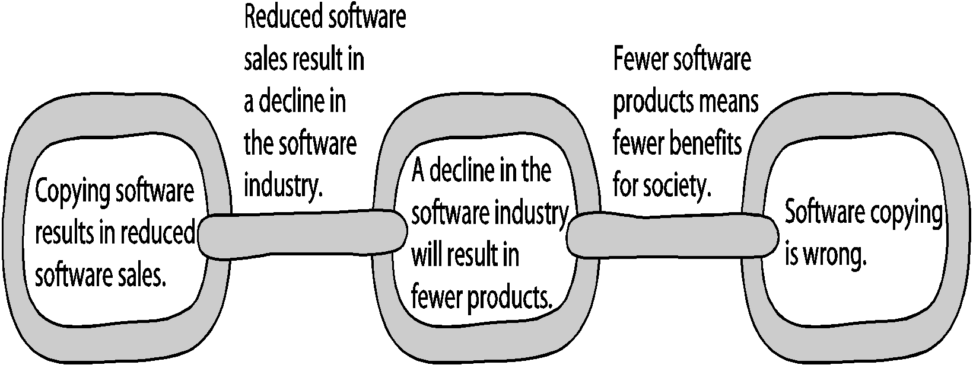

Slide 27
Key Issues: Reverse Engineering
Process of taking something apart in order to understand it, build a copy of it, and improve it.
Applied to computer (hardware & Software). Eg:
Compiler – converts computer program statements expressed in source language to machine learning
Convert a program code to a high-level design
Aim : to enable interoperability
Software license agreements forbid reverse engineering
Ethics of using reverse engineering are debated:
Fair use – useful function/interoperability
Can uncover design that someone else has developed at great cost and taken care to protect.

Slide 28
Key Issues: Open Source Code
Program source code made available for use or modification
Basic premise
Many programmers can help software improve
Can be adapted to meet new needs
Bug rapidly identified and fixed
High reliability
Benefit
New version of program appear more frequently
Eliminates tension between obeying law and helping others
Programs belong to entire community
Shift focus from manufacturing to service
Critique
Without critical mass of developers, quality can be poor
Without “owner” incompatible version may arise
Relatively week graphical user interface
Poor mechanism for stimulating innovation (no companies will spend billions on a new programs)

Slide 29
Competitive Intelligence
Gathering of legally obtainable information
To help a company gain an advantage over rivals
Often integrated into a company’s strategic plans and decision making
Not the same as industrial espionage, which uses illegal means to obtain business information not available to the general public
Without proper management safeguards, it can cross over to industrial espionage

Slide 30
Trade mark Infringement
Trademark is logo, package design, phrase, sound, or word that enables consumer to differentiate one company’s product from another’s
Trademark owner can prevent others from using the same mark or a confusingly similar mark on a product’s label
Organizations frequently sue one another over the use of a trademark in a Web site or domain name
Nominative fair use is defense often employed by defendant in trademark infringement case

Slide 31
Cybersquatting
Cybersquatters
Register domain names for famous trademarks or company names
Hope the trademark’s owner will buy the domain name for a large sum of money
To curb cybersquatting, register all possible domain names
.org, .com, .info

Slide 32
Exercise
A new unique pencil holder design
State the IP: Industrial Design
Description of IP : features of shape, configuration, patent of ornament applied to an article by any industrial process which the finished article appeal to the eye and are judged by the eye.
Argument : A unique design can be referred to feature of shape as mention in Industrial design. This unique design applied to an article (which is pencil holder) that appeal to the eye.

Slide 33
QT/E1:
Explain the appropriate intellectual property protection for the following situation: (No repetition intellectual property protection is allowed)
Inspired by the use of F words of Facebook, Nana modified one word to branding her future chat application
A new invention of rope skipping holder to capture its function, comfortable grip and reading blood pressure

Slide 34
The End

